Slide 1

*metrics Project Group work 3 – Tech Check
*metrics in Transition - Final Workshop
27-28 March 2019
SUB Göttingen
Astrid Orth

Slide 2
Suggestion to check
*metrics prototype
Live http://explore.metrics.gbv.de/
Software: https://github.com/gbv/metrics-crawler
Data
http://api.metrics.gbv.de/v1/work/doi?v=10.1371%2Fjournal.pone.0111629
Data dumps (ask us)
Social Media Registry

Slide 3
Tasks
Topic summary
Recommendations
Future Work

Slide 4
Social Media Registry
In the Social Media Registry (SoMeR) we list:
Social media plattforms and online services, that
Generate and capture social interactions related to scientific products (i.e. articles, datasets, ...)
What do we capture?
Platforms suitable for scientific communication
Types and nature of interactions
Availability and accessibility of social media indicators

Slide 5










SoMeR Top 10

Slide 6
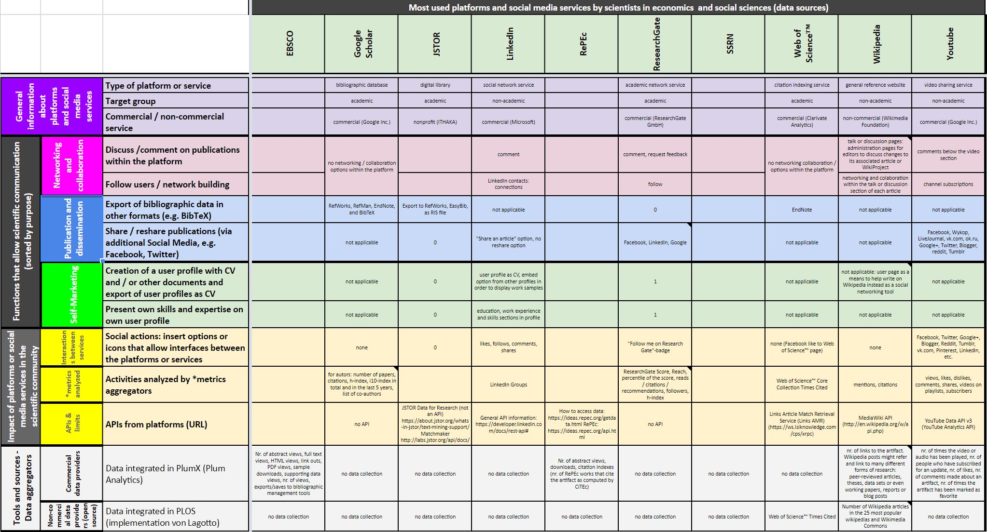
Social Media Registry
Notes:
(Link eingebaut in der Grafik)

Slide 7
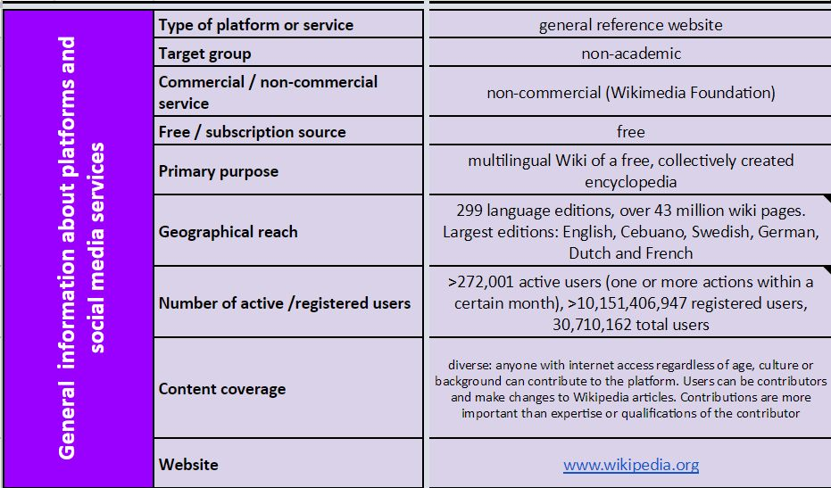
SoMeR Example Wikipedia

Slide 8
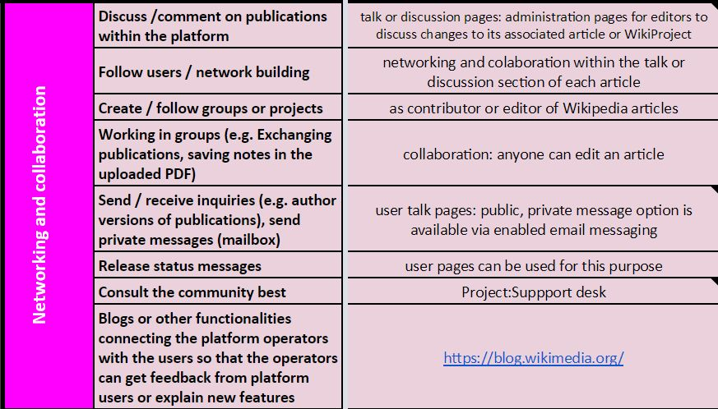
SoMeR Functions Group 1
networking and collaboration

Slide 9
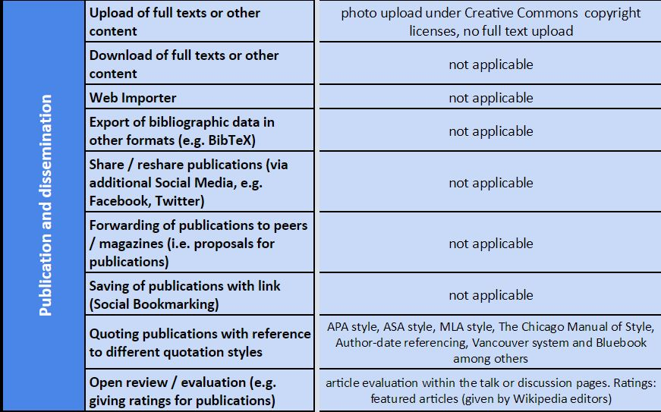
SoMeR Functions Group 2
publication and dissemination

Slide 10
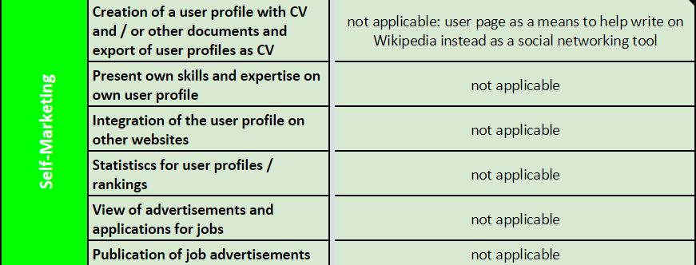
SoMeR Functions Group 3
self-marketing

Slide 11
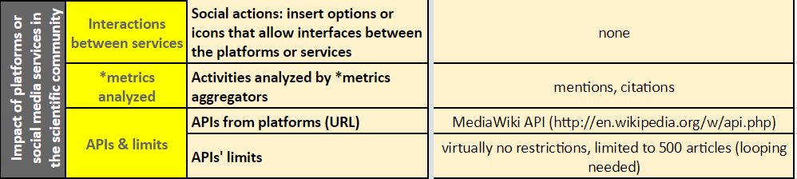
SoMeR – Interactions, *metrics & APIs

Slide 12
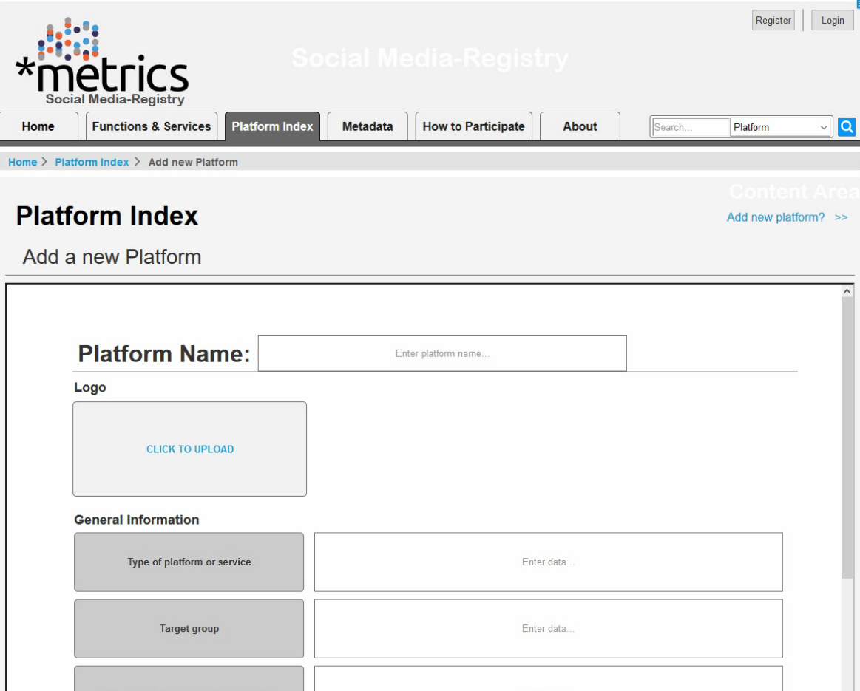
Database version

Slide 13
Discussion
Which platforms should be included?
How open and accessible are platforms?
Which aggregators include data of which platforms?
How are signals captured and aggregated?
Group work

Slide 14
Thank you / Vielen Dank!
Web metrics-project.net
E-Mail metrics-project@sub.uni-goettingen.de
Twitter @metrics_project
Facebook @metricsproject

